Slide 1
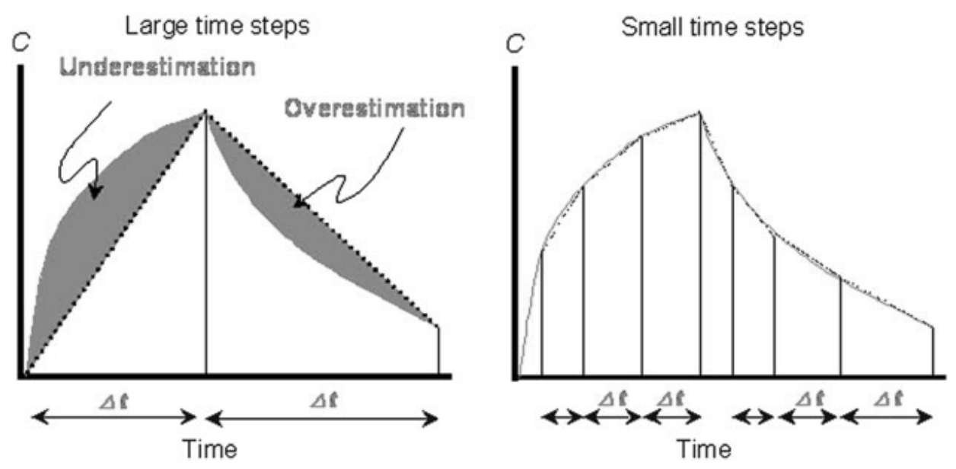
Large sampling interval
Small sampling interval
Underestimation
Overestimation
Concentration
Concentration
Δt
Δt
Δt
Δt
Δt
Δt
Time
Time

Slide 2
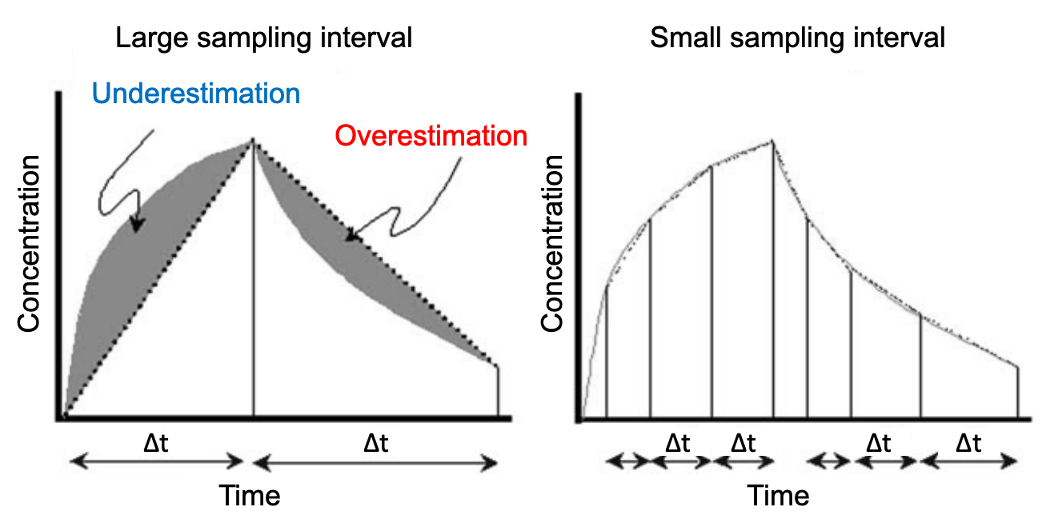

Slide 3
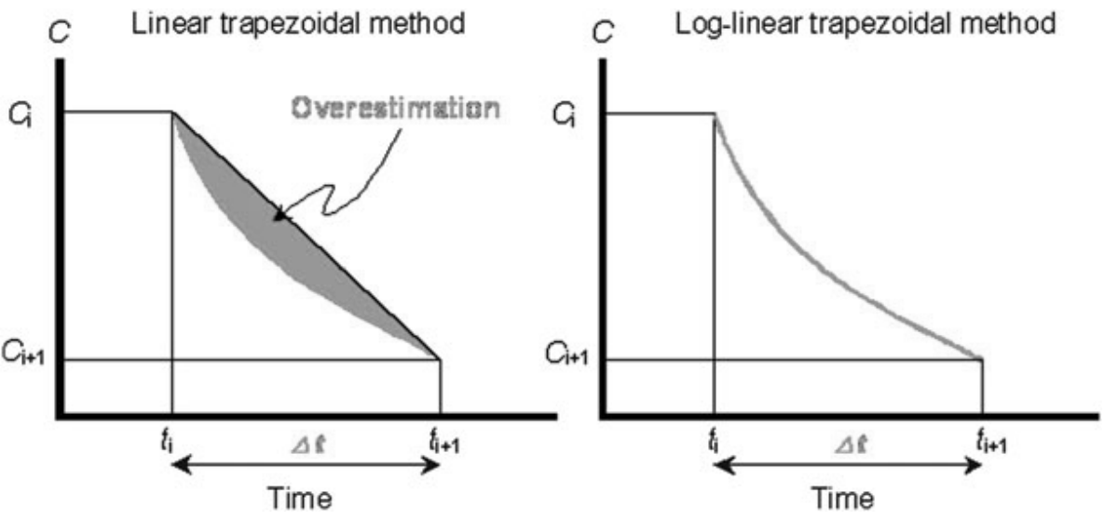
Linear trapezoidal method
Log-linear trapezoidal method
C_{i}
Overestimation
C_{i}
C_{i+1}
C_{i+1}
t_{i}
Δt
t_{i+1}
t_{i}
Δt
t_{i+1}
Time
Time

Slide 4
Linear trapezoidal method
Log-linear trapezoidal method
C_{i}
Overestimation
C_{i}
C_{i+1}
C_{i+1}
t_{i}
Δt
t_{i+1}
t_{i}
Δt
t_{i+1}
Time
Time

Slide 5
Concentration
Lin Log Lin Log Lin Log
Time

Slide 6
Concentration
Lin Log Lin Log Lin Log
Time

Slide 7
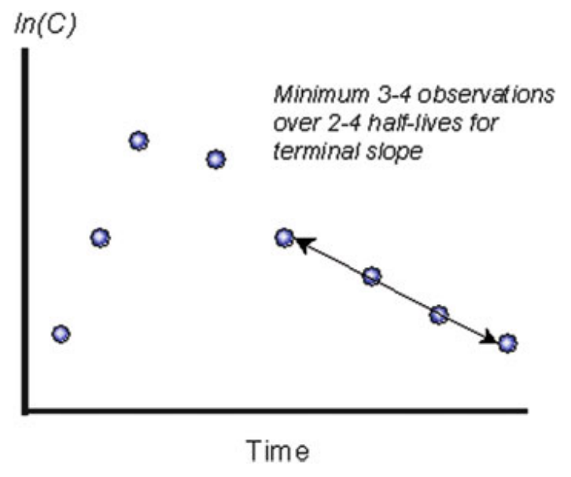
Minimum 3-4 observations over 2-4 half-lives for terminal slope
ln(C)
Time

Slide 8
Minimum 3-4 observations over 2-4 half-lives for terminal slope
ln(C)
Time

Slide 9
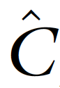
Terminal observation
(C*) is a bit off
C*
C*
ln(C)
ln(C)
Predicted terminal concentration ( ) is more correct
Time
Time

Slide 10
Terminal observation
(C*) is a bit off
C*
C*
ln(C)
ln(C)
Predicted terminal concentration ( ) is more correct
Time
Time

Slide 11
“A”
C_{p(t)} = A * e^{-(α * t)} + B * e^{-(β * t)}
“B”
“Distribution” phase
Cp
“Elimination” phase
10
-β
1.0
-α
0.1
0 1 2 3 4 5 6 7 8
Assumption: K_{a} >> K_{e}
Time

